Slide 1
Chapter 6
Delivery and
Routing of
IP Packets

Slide 2
CONTENTS
CONNECTION
DELIVERY
ROUTING METHODS
STATIC AND DYNAMIC ROUTING
ROUTING TABLE AND MODULE
CLASSLESS ADDRESSING

Slide 3
6.1
CONNECTION-ORIENTED
VERSUS
CONNECTIONLESS
SERVICES

Slide 4
In a connection-oriented situation,
the network layer protocol
first makes a connection.
In a connectionless situation,
the network layer protocol treats each
packet independently,
with each packet having
no relationship to any other packet.

Slide 5
6.2
DIRECT
VERSUS
INDIRECT
DELIVERY

Slide 6
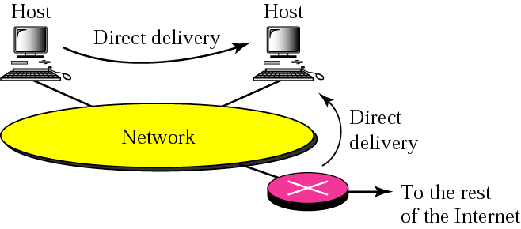
Figure 6-1
Direct delivery

Slide 7
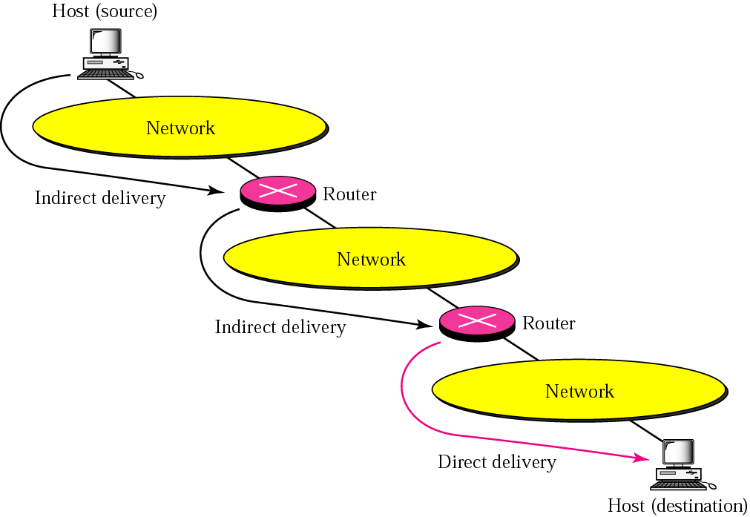
Figure 6-2
Indirect delivery

Slide 8
6.3
ROUTING
METHODS

Slide 9
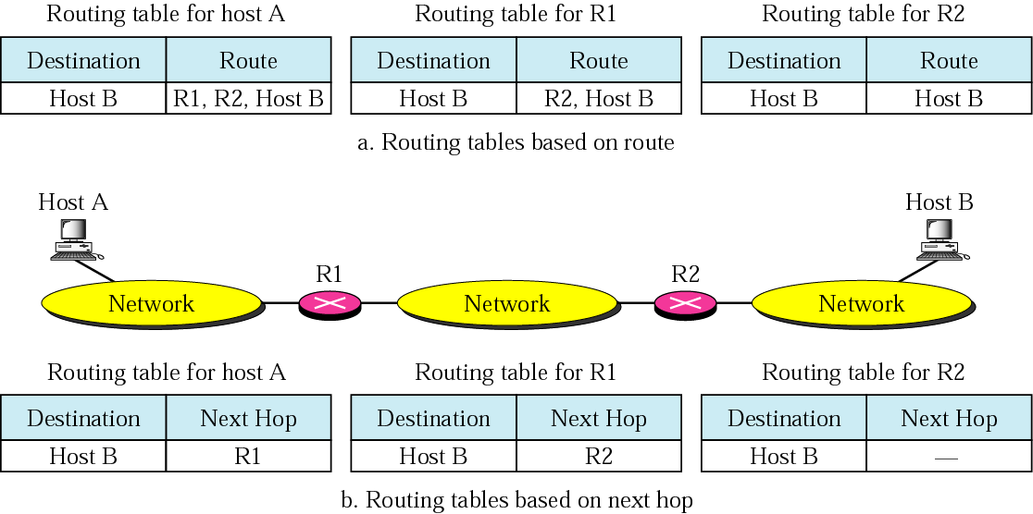
Figure 6-3
Next-hop routing

Slide 10
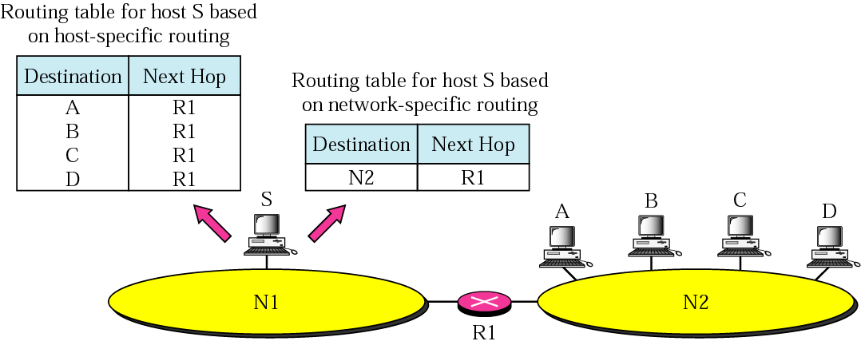
Figure 6-4
Network-specific routing

Slide 11
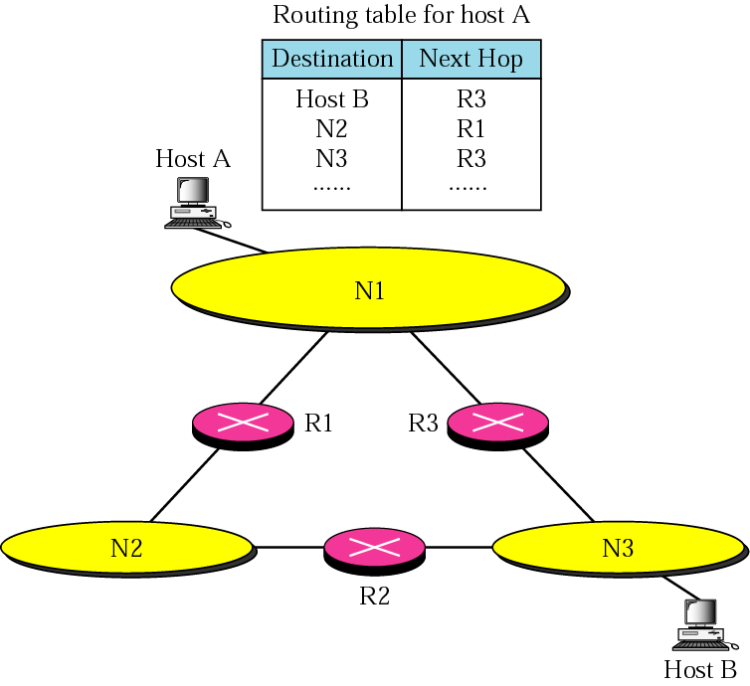
Figure 6-5
Host-specific
routing

Slide 12
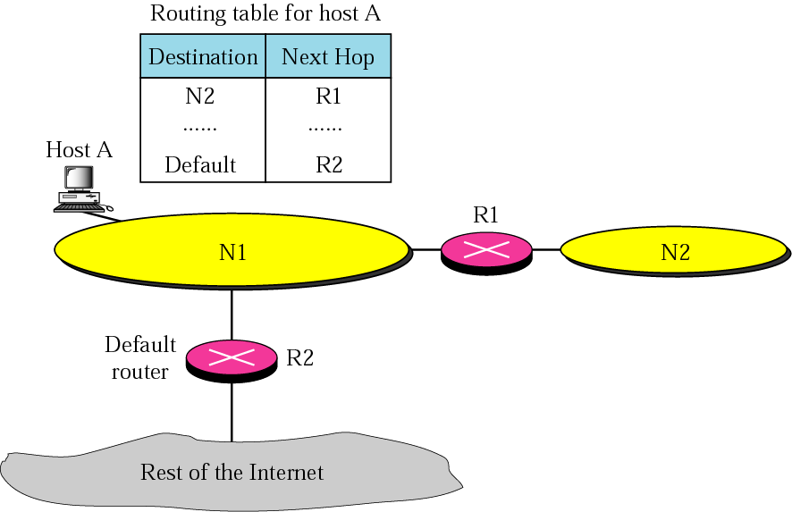
Figure 6-6
Default routing

Slide 13
6.4
STATIC
VERSUS
DYNAMIC
ROUTING

Slide 14
A static routing table
contains information entered manually.
A dynamic routing table is updated
periodically using one of the dynamic
routing protocols such as RIP, OSPF, or BGP.

Slide 15
6.5
ROUTING TABLE
AND
ROUTING MODULE

Slide 16
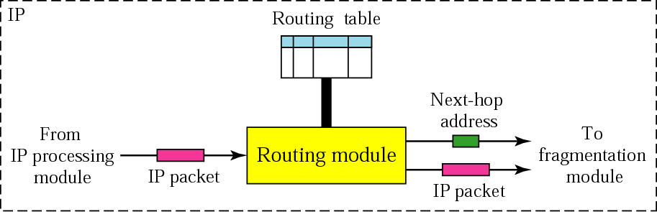
Figure 6-7
Routing module and routing table

Slide 17
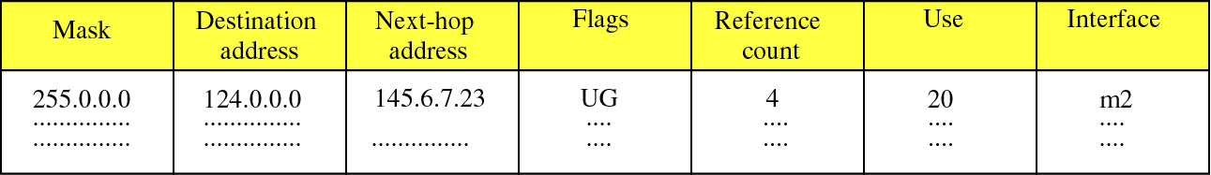
Figure 6-8
Routing Table
Flags
U The router is up and running.
G The destination is in another network.
H Host-specific address.
D Added by redirection.
M Modified by redirection.

Slide 18
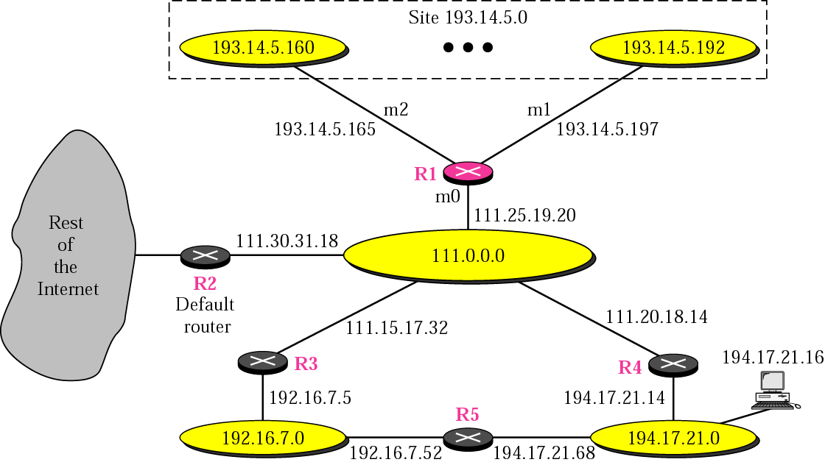
Figure 6-9
Configuration for routing example

Slide 19
Mask Dest. Next Hop I.
255.0.0.0 111.0.0.0 -- m0
255.255.255.224 193.14.5.160 - m2
255.255.255.224 193.14.5.192 - m1
-------------------------------------------------------------------------------------
255.255.255.255 194.17.21.16 111.20.18.14 m0
-------------------------------------------------------------------------------------
255.255.255.0 192.16.7.0 111.15.17.32 m0
255.255.255.0 194.17.21.0 111.20.18.14 m0
-------------------------------------------------------------------------------------
0.0.0.0 0.0.0.0 111.30.31.18 m0

Slide 20
Example 1
Router R1 receives 500 packets for destination 192.16.7.14; the algorithm applies the masks row by row to the destination address until a match (with the value in the second column) is found:

Slide 21
Solution
Direct delivery
192.16.7.14 & 255.0.0.0 ➔ 192.0.0.0 no match
192.16.7.14 & 255.255.255.224 ➔ 192.16.7.0 no match
192.16.7.14 & 255.255.255.224 ➔ 192.16.7. no match
Host-specific
192.16.7.14 & 255.255.255.255 ➔192.16.7.14 no match
Network-specific
192.16.7.14 & 255.255.255.0 ➔192.16.7.0 match

Slide 22
Example 2
Router R1 receives 100 packets for destination 193.14.5.176; the algorithm applies the masks row by row to the destination address until a match is found:

Slide 23
Solution
Direct delivery
193.14.5.176 & 255.0.0.0 ➔ 193.0.0.0 no match
193.14.5.176 & 255.255.255.224 ➔193.14.5.160 match

Slide 24
Example 3
Router R1 receives 20 packets for destination 200.34.12.34; the algorithm applies the masks row by row to the destination address until a match is found:

Slide 25
Solution
Direct delivery
200.34.12.34 & 255.0.0.0 ➔200.0.0.0 no match
200.34.12.34 & 255.255.255.224 ➔200.34.12.32 no match
200.34.12.34 & 255.255.255.224 ➔200.34.12.32 no match
Host-specific
200.34.12.34 & 255.255.255.255 ➔200.34.12.34 no match

Slide 26
Solution
Network-specific
200.34.12.34 & 255.255.255.0 ➔ 200.34.12.0 no match
200.34.12.34 & 255.255.255.0 ➔ 200.34.12.0 no match
Default
200.34.12.34 & 0.0.0.0 ➔ 0.0.0.0. match

Slide 27
Example 4
Make the routing table for router R1 in Figure 6.10

Slide 28
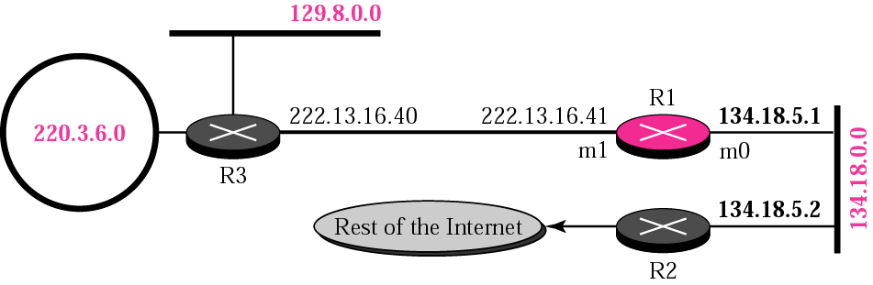
Figure 6-10
Example 4

Slide 29
Solution
Mask Destination Next Hop I.
255.255.0.0 134.18.0.0 -- m0
255.255.0.0 129.8.0.0 222.13.16.40 m1
255.255.255.0 220.3.6.0 222.13.16.40 m1
0.0.0.0 0.0.0.0 134.18.5.2 m0

Slide 30
Example 5
Make the routing table for router R1 in Figure 6.11

Slide 31
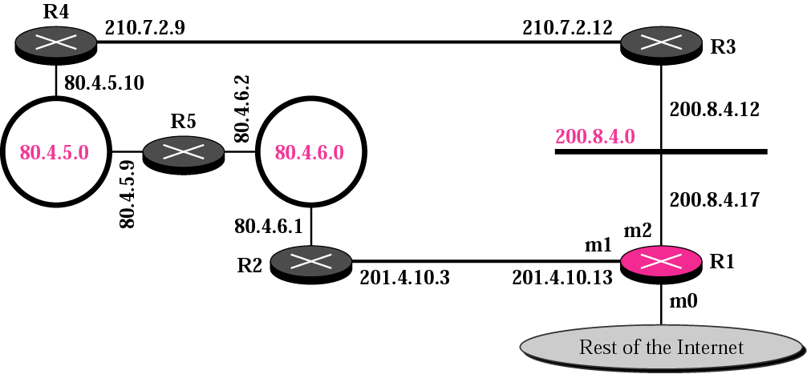
Figure 6-11
Example 5

Slide 32
Solution
Mask Destination Next Hop I.
255.255.255.0 200.8.4.0 ---- m2
-----------------------------------------------------------------------------
255.255.255.0 80.4.5.0 201.4.10.3 m1
or 200.8.4.12 or m2
------------------------------------------------------------------------------
255.255.255.0 80.4.6.0 201.4.10.3 m1
or 200.4.8.12 or m2
-------------------------------------------------------------------------------
0.0.0.0 0.0.0.0 ???????????? m0

Slide 33
Example 6
The routing table for router R1 is given below.
Draw its topology
Mask Destination Next Hop I.
255.255.0.0 110.70.0.0 - m0
255.255.0.0 180.14.0.0 - m2
255.255.0.0 190.17.0.0 - m1
255.255.0.0 130.4.0.0 190.17.6.5 m1
255.255.0.0 140.6.0.0 180.14.2.5 m2
0.0.0.0 0.0.0.0 110.70.4.6 m0

Slide 34
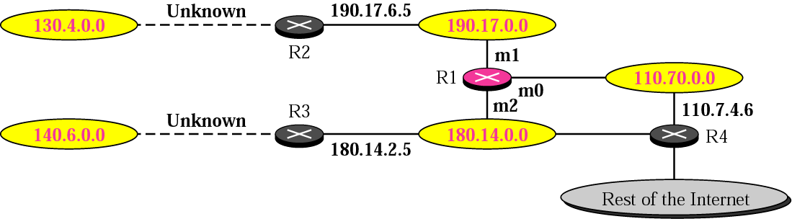
Figure 6-12
Example 6
(Solution)

Slide 35
6.6
CLASSLESS
ADDRESSING:
CIDR

Slide 36
ISSUES
Routing Table Size
Hierarchical Routing
Geographical Routing
Routing Table Search Algorithms

Slide 37

In classful addressing,
each address has self-contained
information that facilitates
routing table searching.

Slide 38
In classless addressing, there is
no self-contained information
in the destination address to
facilitate routing table searching.

